Slide 1

CLOUDCART
TEAM 15
Anto P V
Vivek Mohan
V Yadhu krishnan

Slide 2
PROBLEM STATMENT
Amid this COVID-19 pandemic, it is not recommended to be outside for long periods. Buying goods and services for necessary purposes is also unattainable since home delivery and visiting shops are insecure.
<number>

Slide 3

WHY CLOUDCART?
With CloudCart, one can book items/services and also pay for those items sitting at home. Customers can choose the time slot during which they want to go and take their products from the shop, but only a limited amount of people can only book in a particular slot. This is done to reduce the rush and time that people are being outside.
<number>

Slide 4
Flow Chart
1

Slide 5
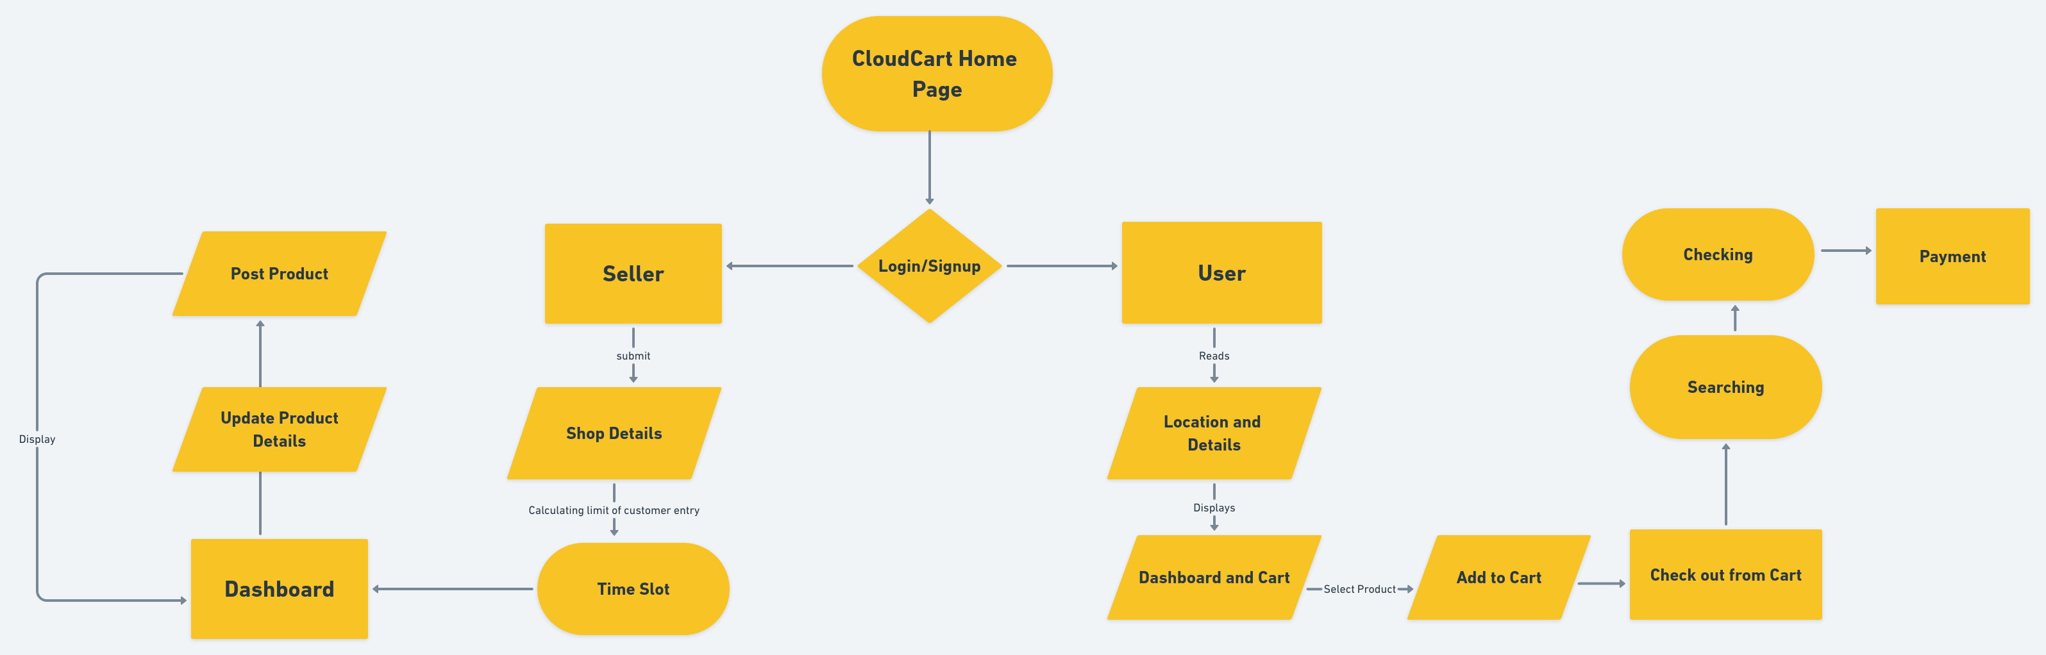

Slide 6
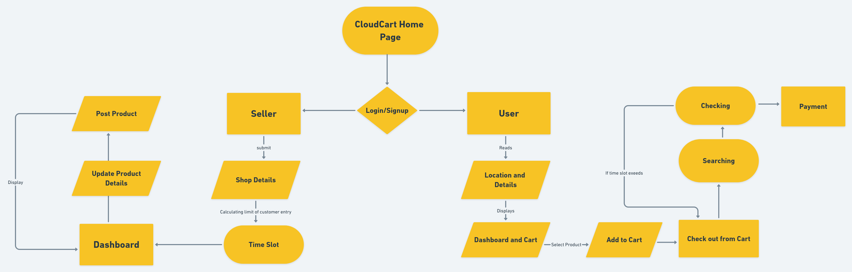

Slide 7
2
TABLES

Slide 8
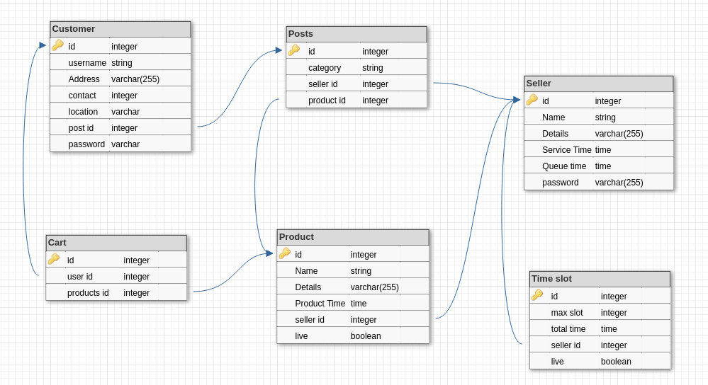
<number>

Slide 9
ALGORITHM
<number>

Slide 10
Searching Algorithm
Step 1: Start
Step 2: Creating a Shopstack(dictionary)
Step 3: Repeat each product
3.1: if shop id is in Shopstack
pass
3.2: else
update Shopstack
Read a slot from all available slots
of shop from user input time period.
Step 4: If user input time period is >= one time slot
4.1: Input all time slots where maximum
products are available.
<number>

Slide 11
Step 5: Takes final time slot as user choose
Step 6: Outputs the available products
Step 7: Stop
<number>

Slide 12
Checking Algorithm
Step 1: Start
Step 2: Initializing user_time and temp_time to zero
Step 3: Read and Intialize Shopstack
3.1: Read all product_time
3.2: temp_time= temp_time+service_time
Step 4: user_time=sum(product_time)+temp_time
+sum(Queue_time)
Step 5: if user_time > 1
5.1: print(“can’t purcase this in 1 hour,reduce items”)
5.2: Checkout_Cart()
Step 6: else
6.1: payment()
Step 7: Stop
<number>

Slide 13
Queue_time Algorithm
Step 1: Start
Step 2: Reading service_time and all product time
Step 3: Initializing max_limit=60
Step 4: if service_time=0
4.1: service_time=min(product_time)
Step 5: min_limit=60/service_time
Step 6: if(min_limit>max_limit)
min_limit=max_limit
Step 7: Reads slot input as limit
Step 8: if lim>min_limit
8.1:print(“can’t give slots greater than”,min_limit)
8.2: Jump to Step 7
<number>

Slide 14
Step 9: else
9.1:if limit>=3
queue_time=(60-service_time)/limit
9.2: else queue_time=0
Step 10: Stop
<number>

Slide 15

TECHNOLOGIES USED
MongoDB - Express.js - React - Node.js
<number>

Slide 16
THANK YOU
<number>

